Slide 1
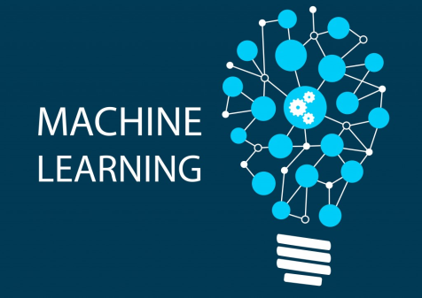
Natural Language Processing (NLP) Machine Learning
Diptangshu Banik
Twitter @dipbanik

Slide 2
Overview
Natural Language Processing (or NLP) is applying Machine Learning models to text and language.
Sentiment Analysis – use text review to predict if the review is a good one or a bad one.
predict some categories of the articles.
predict the genre of the book

Slide 3
Use NLP to build a machine translator or a speech recognition system
Question Answering – Chatbots
Document Sumarization
Natural Language Understanding – LUIS, Google Dailogflow, Amazon Lex.

Slide 4
Python Libraries
Natural Language Toolkit – NLTK
SpaCy
Stanford NLP
OpenNLP

Slide 5
Algo
Most of NLP algorithms are classification models
Logistic Regression
Naive Bayes
CART which is a model based on decision trees
Maximum Entropy again related to Decision Trees
Hidden Markov Models which are models based on Markov processes
C 5.0 – Decision Tree based model

Slide 6
Algo
A very well-known model in NLP is the Bag of Words model. It is a model used to preprocess the texts to classify before fitting the classification algorithms on the observations containing the texts.

Slide 7
Steps - Bag of Words
Clean texts to prepare them for the Machine Learning models
Create a Bag of Words model
Apply Machine Learning models onto this Bag of Worlds model.

Slide 8
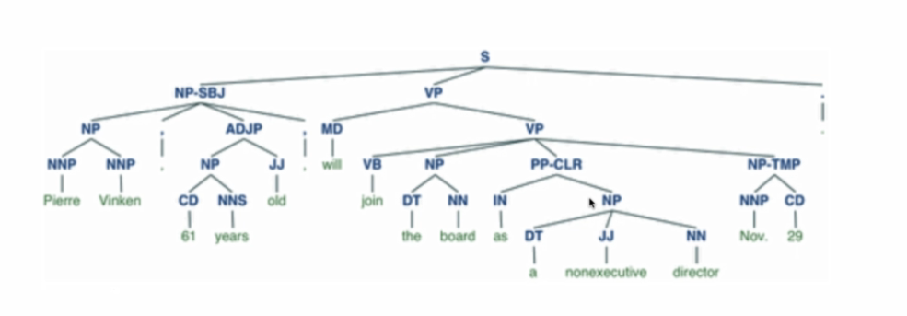
Parts of Speech Tagging
Parts of Speech Tagging for a sentence

Slide 9
Parts of Speech Tagging
Wikipedia Desc –
Marking up a word in a text (corpus) as corresponding to a particular part of speech, based on both its definition and its context — i.e., its relationship with adjacent and related words in a phrase, sentence, or paragraph. A simplified form of this is commonly taught to school-age children, in the identification of words as nouns, verbs, adjectives, adverbs, etc.

Slide 10
Stop Words
These are words which do not add any value to the text and are only used for stitching words together.
Examples – for, the, a, an, of, it, . , ?, etc.

Slide 11
Stemming
Stemming is the process of reducing a word to its word stem that affixes to suffixes and prefixes or to the roots of words known as a lemma.
Love = love
Loved = love
Loving = love

Slide 12
TF-IDF
Term frequency–inverse document frequency
A numerical statistic that is intended to reflect how important a word is to a document in a collection or corpus.
Used as a weighting factor in searches of information retrieval, text mining, and user modeling.
The tf–idf value increases proportionally to the number of times a word appears in the document and is offset by the number of documents in the corpus that contain the word, which helps to adjust for the fact that some words appear more frequently in general.
Tf–idf is one of the most popular term-weighting schemes today; 83% of text-based recommender systems in digital libraries use tf–idf.

